Slide 1

  Analytics-Driven Cloud Disaster Recovery and Intelligent Failover Management
  Team no. 3
  CSA1520– Cloud computing and Big Data analytics
  Guided By Students Name
  Dr.A.M.Arul Raj Yashmita G (192511032)
  Professor Sanjana G (192511020)
  Pavithra V (192524274)
  Dharshana D (192524243)
  Turlapati Anurupa (192524160)
Notes:
1
1

Slide 2
Abstract
Cloud service disruption and unexpected downtime
Distributed backup storage across cloud regions
Continuous health monitoring of services and resources
Analytics-based outage detection and recovery decisions
Automated failover to healthy standby infrastructure
Data consistency checks and recovery status reporting

Slide 3
Aim and Objective
Aim
To develop an analytics-driven system that detects cloud failures and performs intelligent disaster recovery automatically.
Objectives
Monitor cloud services and infrastructure continuously.
Detect anomalies and predict potential cloud failures.
Maintain replicated backups across cloud environments.
Automatically switch workloads to a healthy standby cloud.
Generate alerts and maintain recovery logs.20

Slide 4
Introduction
Cloud computing provides scalable storage, applications, and services.
Cloud failures can cause downtime and data loss.
Traditional recovery methods may depend on manual intervention.
Predictive analytics helps identify potential failures early.
Intelligent failover redirects services to a standby cloud.
This project combines monitoring, prediction, backup, and automated recovery.

Slide 5
Literature Review
S.No | Year of Publication | Author | Title of the Journal / book | Methodology used | Algorithm used | Key Findings
1 | 2023 | Raghava Chellu | AI-Powered Intelligent Disaster Recovery | Cloud telemetry analysis | LSTM | Predicts failures and improves recovery.
2 | 2023 | Hassan Raza | Driven Disaster Recovery in Distributed Cloud Systems | Predictive monitoring | LSTM, Federated Learning | Supports proactive recovery and resource optimization.
3 | 2024 | Figen Özen & Alireza Souri | Cloud-Based Disaster Management Architecture | Hybrid machine learning | Hybrid ML | Improves disaster assessment using cloud and IoT data.
4 | 2025 | Sathish Kuppan Pandurangan | Advanced Disaster Recovery System in Cloud Infrastructure | Backup and replication | Automated orchestration | Supports multi-region recovery and business continuity.
5 | 2026 | Kun Meng | Cloud Disaster Recovery Model Based on Failure Prediction | Time-series prediction | ED-LSTM | Predicts failures and reduces recovery time.

Slide 6
Problem Statement
Cloud failures can interrupt services and affect business continuity
Manual detection and recovery increase response time
Separate monitoring and backup tools complicate recovery coordination
Unverified failover may redirect traffic to unhealthy resources
Need: analytics-driven outage detection and controlled recovery orchestration
Target outcomes: lower recovery time, limited data loss and improved availability

Slide 7
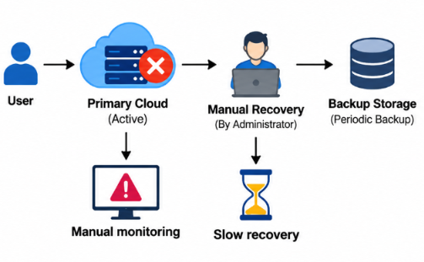
Existing System
Periodic monitoring of cloud resources and services.
Scheduled backups and regular data replication.
Manual failure detection and recovery operations.
Static failover rules for service restoration.
Limited predictive analysis and recovery validation processes.

Slide 8
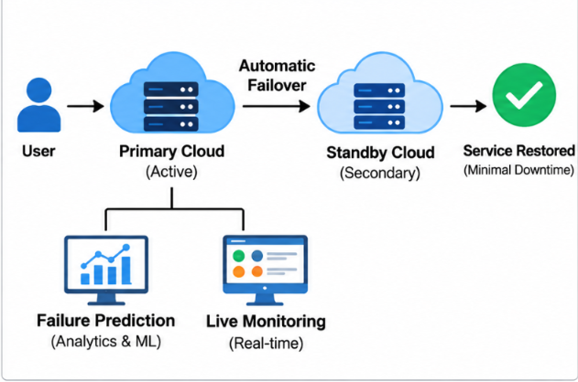
Proposed System
Real-time cloud monitoring and telemetry collection.
Analytics-based anomaly and failure prediction.
Replicated backups across cloud regions.
Automated failover to a healthy standby cloud.
Recovery validation, alerts, and performance reports.

Slide 9
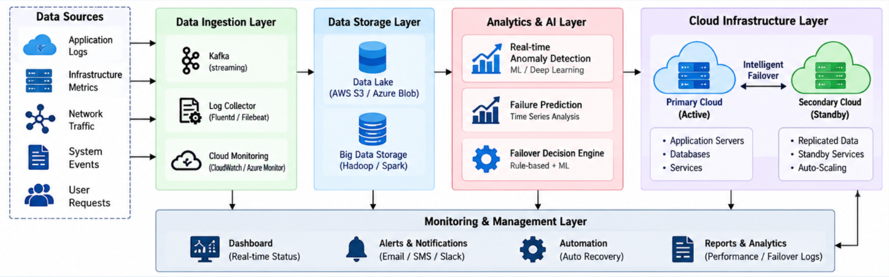
Overall System Architectural Design

Slide 10




Sustainable Development Goal (SDG) Implementation
SDG 9 - Industry, Innovation and Infrastructure
Strengthens cloud infrastructure against unexpected failures.
Improves system reliability through intelligent disaster recovery.
SDG 11 - Sustainable Cities and Communities
Ensures continuous digital services during system failures.
Enables faster recovery of critical urban IT services.

Slide 11
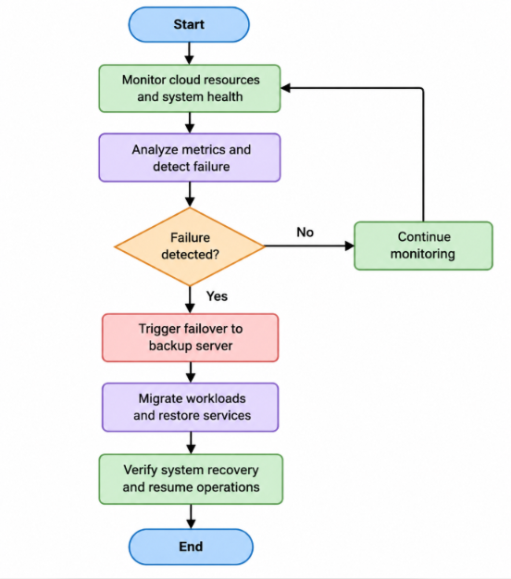
Proposed Methodology and Algorithm
Algorithm: Analytics-Driven Intelligent Failover and Disaster Recovery Algorithm

Slide 12
Design & Module Planning
Module 1 – Telemetry Collection: service probes, logs and cloud metrics.
Module 2 – Analytics & Detection: thresholds, trend analysis and anomaly score.
Module 3 – Backup & Replication: snapshots, replication lag and recovery points.
Module 4 – Failover Orchestration: policy evaluation, target selection and traffic switch.
Module 5 – Dashboard & Reporting: live status, alerts, recovery history and audit logs.

Slide 13
Conclusion
Enhances cloud infrastructure reliability through intelligent failover mechanisms.
Uses real-time analytics to detect failures and support faster recovery decisions.
Minimizes service downtime by automatically switching to backup cloud resources.
Ensures business continuity and improves the availability of critical digital services.
Supports SDG 9 and SDG 11 by promoting resilient infrastructure and reliable digital services.

Slide 14
References
NIST, “Security and Privacy Controls,” 2020. https://doi.org/10.6028/NIST.SP.800-53r5
Amazon Web Services, “Disaster Recovery of Workloads on AWS,” 2021. https://shorturl.at/aws-dr
E. B. Khiyami and S. Shanker, “Building a Disaster Recovery Site on AWS for Workloads on Microsoft Azure,” AWS, 2023.https://shorturl.at/multicloud-dr.
Google Cloud, “Architecting Disaster Recovery for Cloud Infrastructure Outages,” 2024. https://shorturl.at/cloud-dr
Amazon Web Services, “Disaster Recovery Options in the Cloud,” AWS. https://shorturl.at/aws-dr
Google Cloud, “Disaster Recovery Scenarios for Applications,” 2024. https://shorturl.at/gcp-app
Google Cloud, “Disaster Recovery Building Blocks,” 2024. https://shorturl.at/gcp-blocks

Slide 15


